Slide 1
D-310 Unit 2: Equipment

Slide 2
Objectives
Students will be able to:
Mobilize, reassign, and demobilize equipment in a safe and cost-effective manner.
Determine the information needed to utilize supplemental forms to mobilize national contract caterer and shower units.
Identify equipment types and sources and unique ordering procedures.
Describe the equipment demobilization process.
Describe the interaction the equipment dispatcher must have with other functional areas within the incident support organization.

Slide 3

Incident Position Standards Alignment
This unit aligns with the following Expanded Dispatch Support Dispatcher (EDSD) Incident Position Standards located at
https://www.nwcg.gov/positions/expanded-dispatch-support-dispatcher/standards-and-references.
EDSD responsibility alignment
Obtain situational awareness.
Review and manage existing requests.
Receive and manage new requests.
Communicate and manage resources in preparation for reassignment or demobilization.
Perform effectively in each of the four functional areas.
Establish and maintain communication with frequent contacts.
Complete all administrative tasks and documentation in an accurate and timely manner.
Prepare for and implement demobilization.

Slide 4
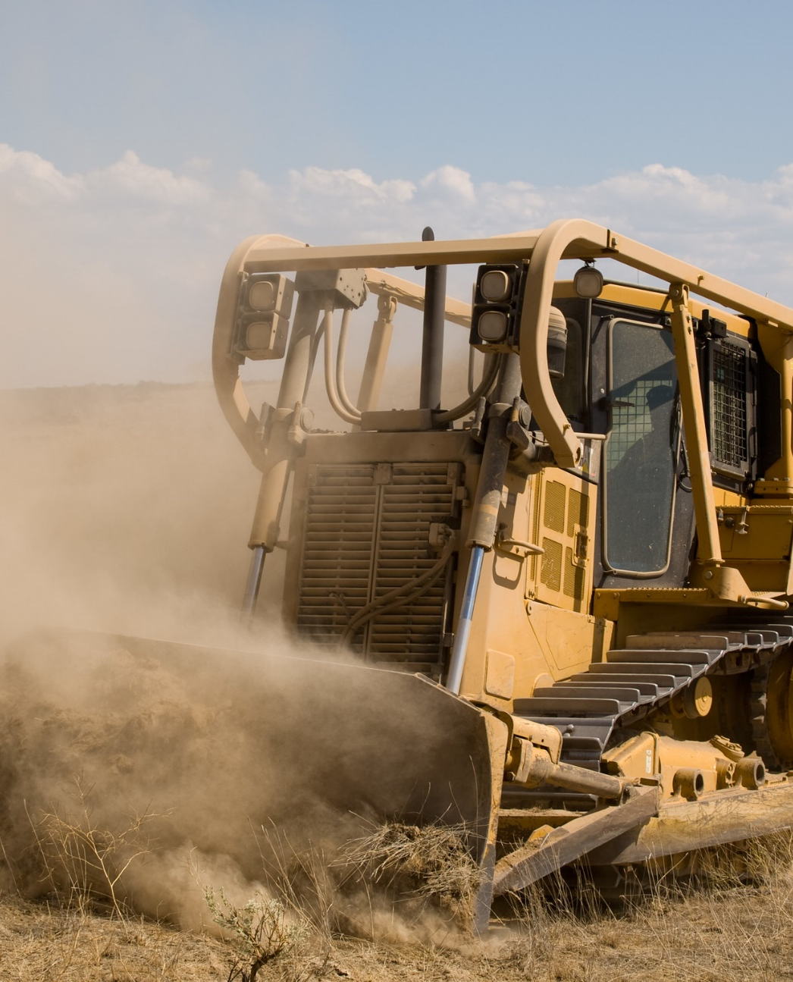
Equipment Resources
National mobile caterers and mobile shower facilities
Engines
Rolling stock
Specialized equipment
Notes:
Dozers Cut Fireline on Wildfires | When a wildfire starts, l… | Flickr

Slide 5
National Resources: Equipment
National Resources are those which have national utilization, high demand, limited availability, and unique status reporting requirements identified by NICC.
• National Contract Mobile Food Services Units
• National Contract Mobile Shower Facilities.

Slide 6
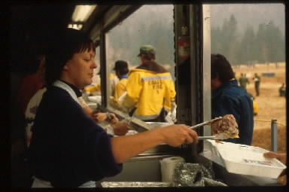
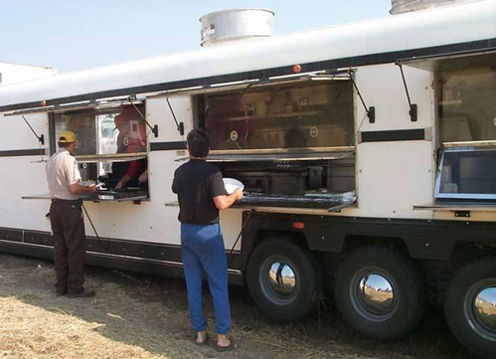
Mobile Food Services (1 of 3)
Required Federal use when the number of people to be fed is at or above 200 persons per meal and the headcount is estimated to remain at those numbers, or greater, for at least 72 hours from when the headcount first reaches 200 per meal

Slide 7
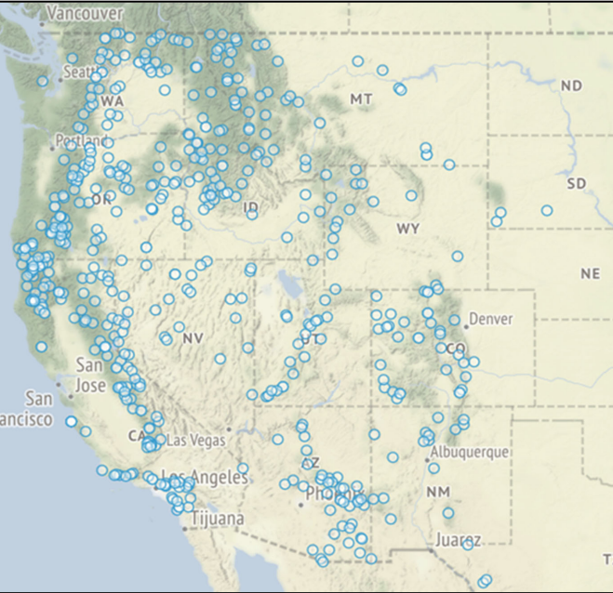
Mobile Food Services (2 of 3)
Number of units, locations, and mandatory availability period

Slide 8
Mobile Food Services (3 of 3)
Information required when ordering:
Name of incident, resource order number, financial code, and request number
Exact reporting location- must match resource order
Estimated time needed- must match resource order
Estimated number of meals for dinner, breakfast and lunch.
Dispatch contact information
Contact information for incident (typically Food Unit Leader [FDUL])

Slide 9
Mobile Shower Facilities (1 of 2)
Information required when ordering
Name of incident, resource order number, financial code, and request number
Exact reporting location
Estimated time needed
Size of shower unit: large (12+ stalls) or small (4-11 stalls)
Contact information for additional ordering information
Contact information for incident (typically Facilities Unit Leader [FACL])

Slide 10
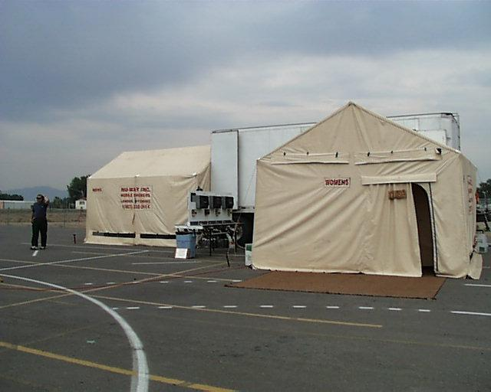
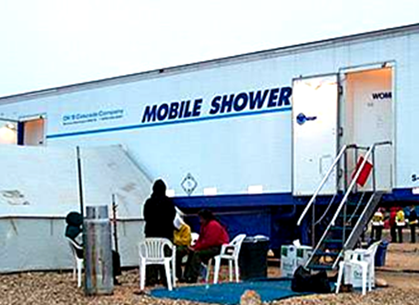
Mobile Shower Facilities (2 of 2)
Mobile shower facilities arrive on scene with potable water and water tender for continuous support.
Contractor may arrive with additional/optional equipment (e.g., hand washing units, Americans with Disabilities Act [ADA] shower stalls).
Incident is responsible for removal of waste (grey) water.

Slide 11
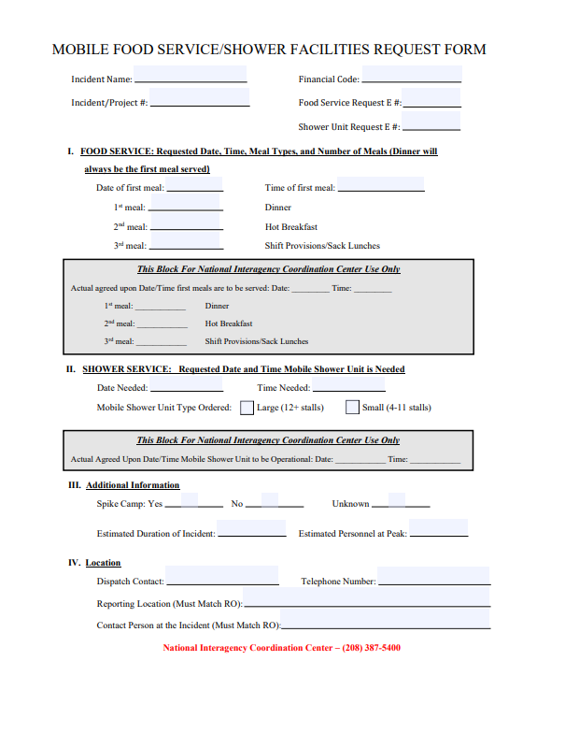
Activity: Mobile Food & Shower Service Request Form (1 of 2)

Slide 12
Activity: Mobile Food & Shower Service Request Form (2 of 2)
Incident Name: Round Up
Resource Order #: ID-BOF-004079
Financial Code: P4ABC2
Food Service Request E#: E-28
Date of first meal: Today’s date
First meal: Dinner tomorrow
Persons Assigned: 15 crews, 2 camp crews, 20 engines, 45 overhead, and 8 helicopters
Reporting location: ICP-3830 ID-21, Idaho City, ID 83631
Contact person at the Incident: FDUL - Jene Jones
Spike Camps: No
Potable Water: In Idaho City, one mile away
Estimated Duration of Incident: 7 days
Estimated Personnel at Peak: 760
Dispatch Contact: EQ Desk
Telephone Number: 208-333-5555

Slide 13
Demobilization
Local units will notify their GACC twenty-four (24) hours in advance of demobilization.
All release information will be entered into IROC within fifteen (15) minutes of demobilization.
Requests to reassign these resources will be placed by the local unit to the Geographic Area Coordination Center (GACC).
GACC will forward the request to NICC.
All reassignments of national units will be approved by NICC.

Slide 14
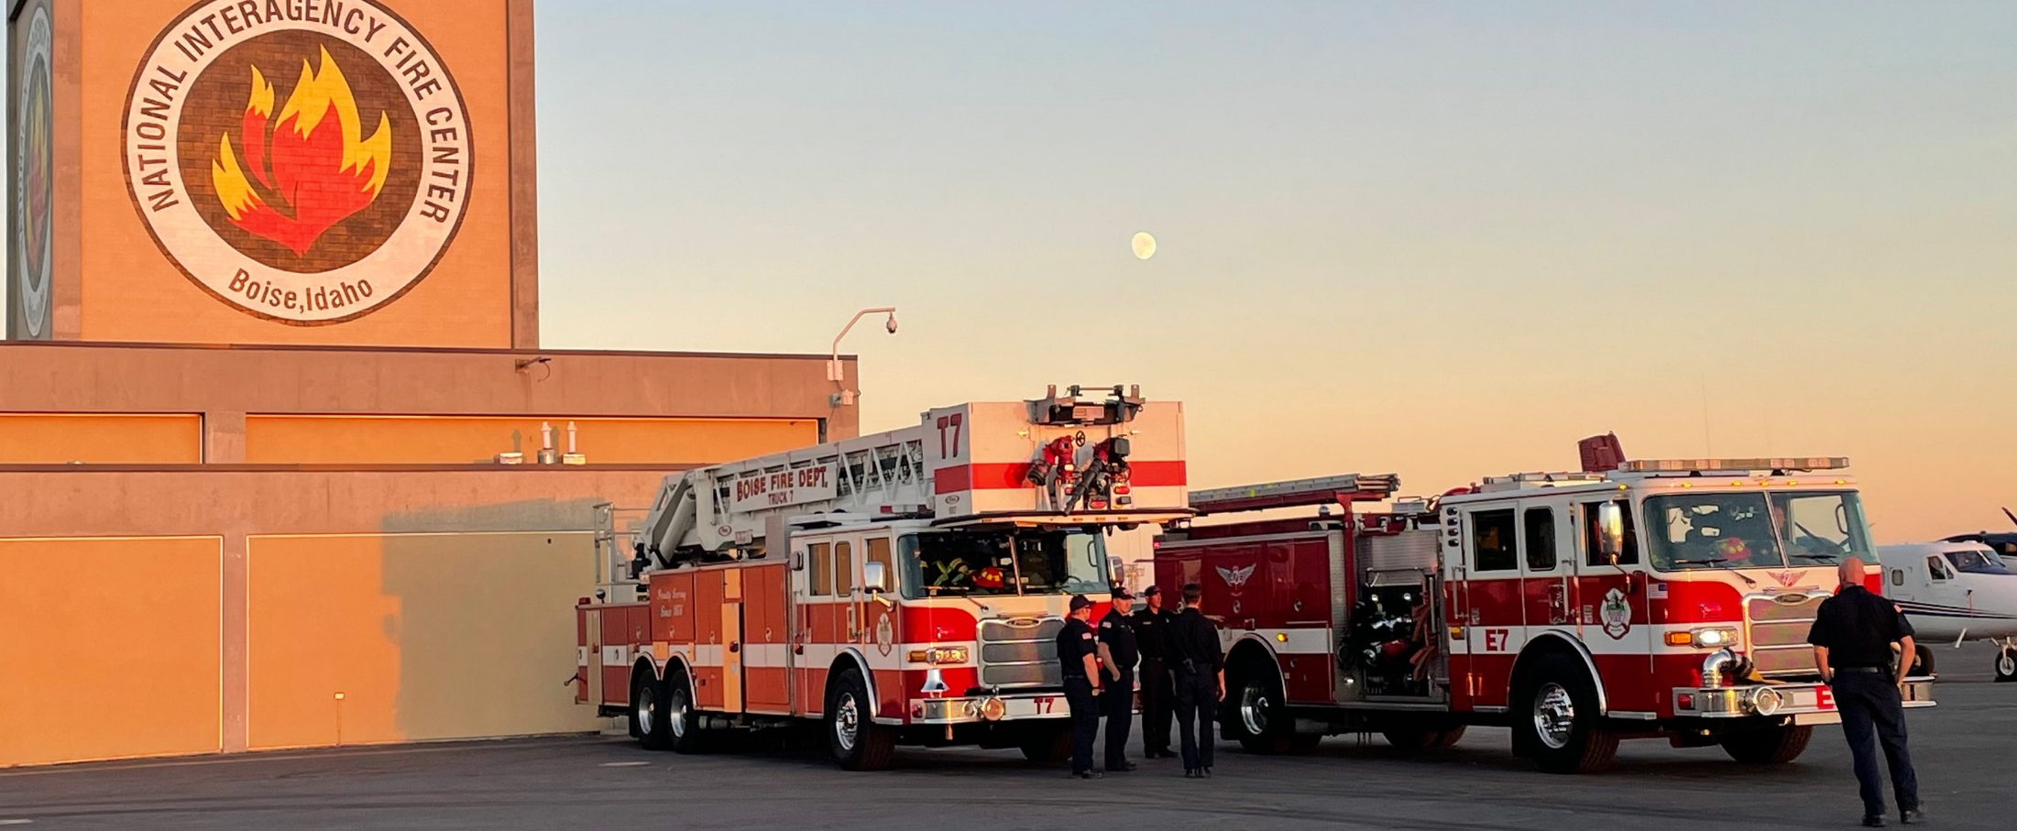
Type 1 & 2 Structure Engines
Minimum requirements
Type 1 – Gallons per minute (GPM) 1,000+, 1,200 ft. hose, 4 personnel
Type 2 – GPM 500+, 1,000 ft. hose, 3 personnel
Notes:
Light The Night NIFC | NIFC participated in the 2022 Light t… | Flickr

Slide 15
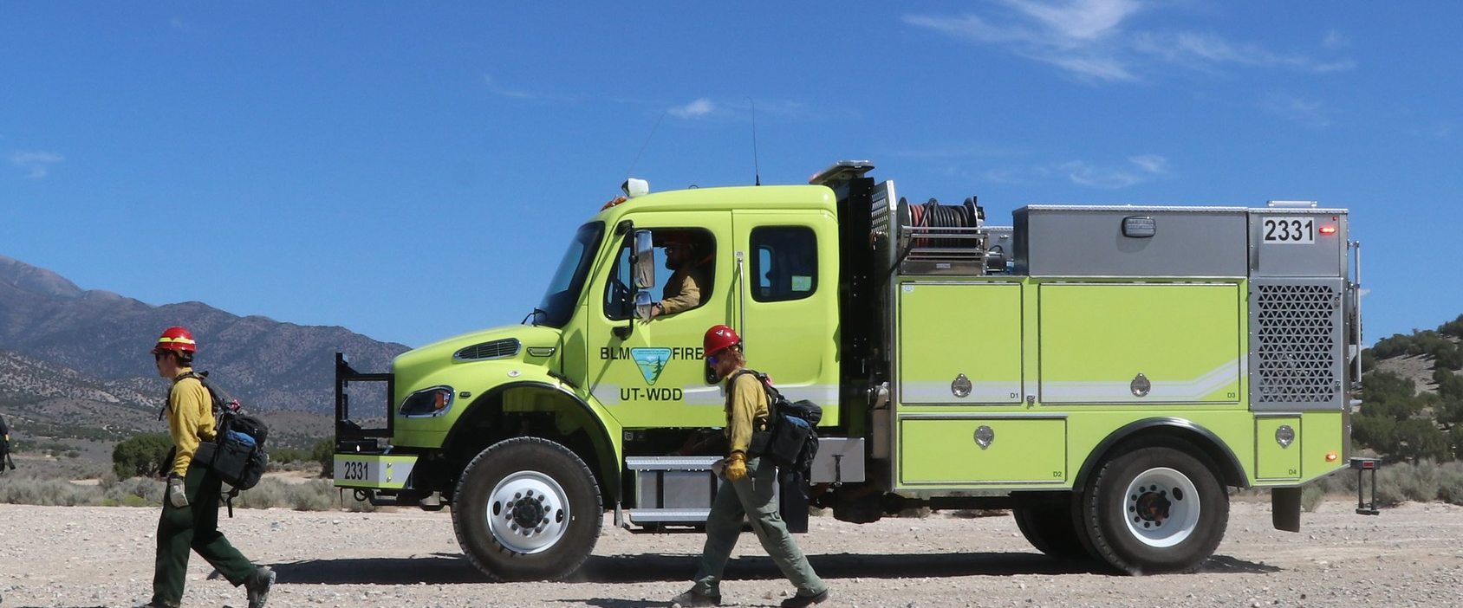
Type 3 & 4 Wildland Engines
Minimum requirements
Type 3 – GPM 150, 1,000 ft. hose, 3 personnel
Type 4 – GPM 50, 300 ft. hose, 2 personnel
Notes:
Mobile Attack Practice, Lehi, Utah | The crew of a Type 4 Fi… | Flickr

Slide 16
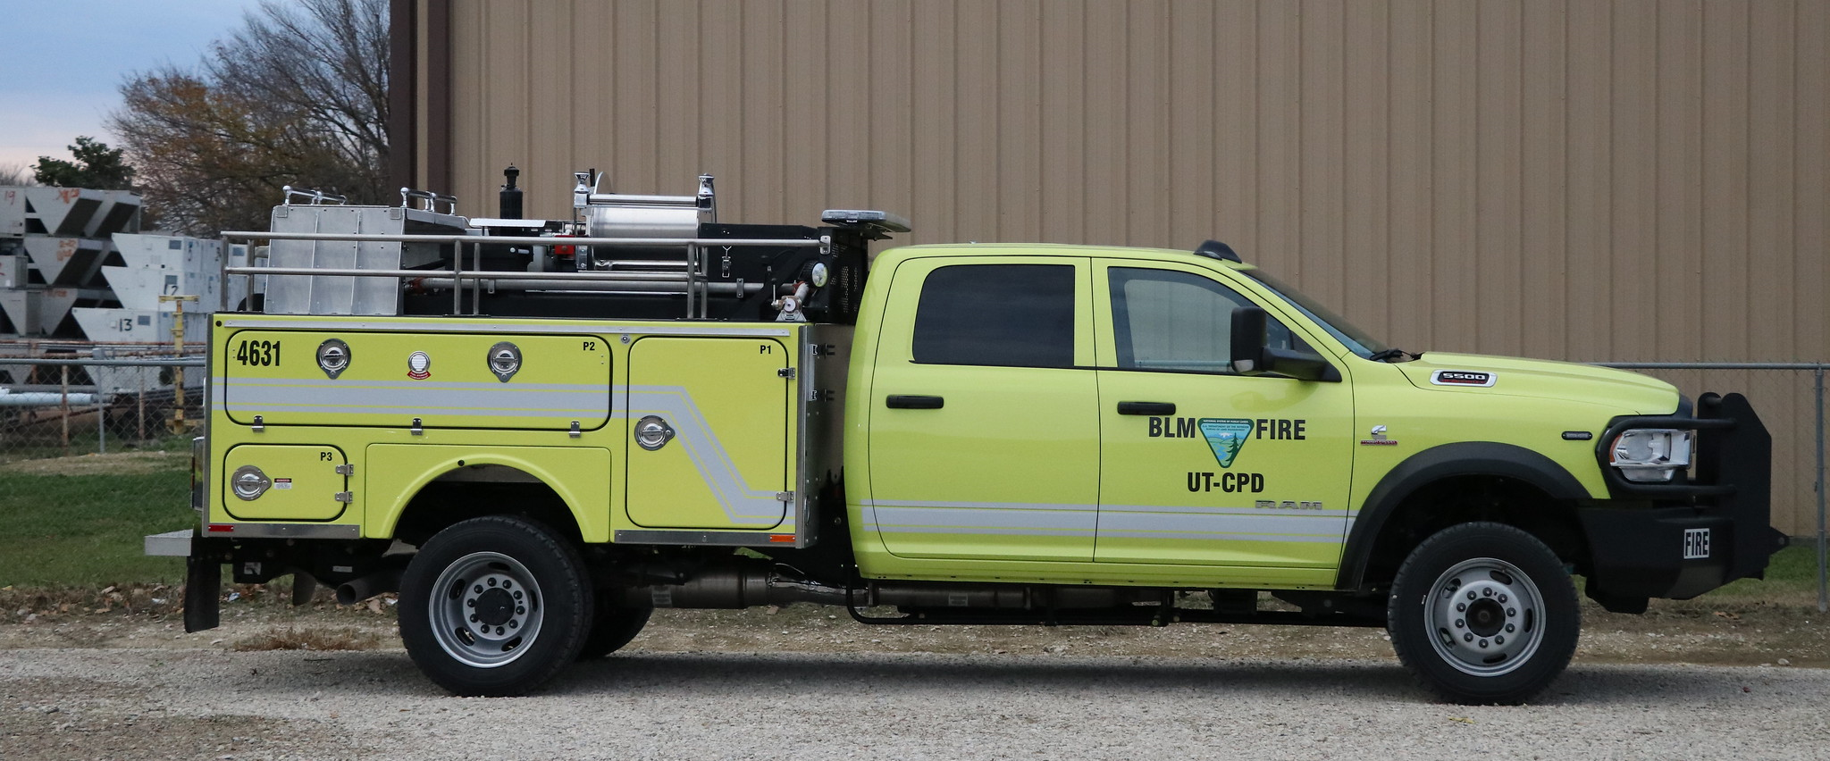
Type 5 & 6 Wildland Engines
Minimum requirements
Type 5 – GPM 50, 300 ft. hose, 2 personnel
Type 6 – GPM 50, 300 ft. hose, 2 personnel
Notes:
BLM Equipment Inspections | The Bureau of Land Management se… | Flickr

Slide 17
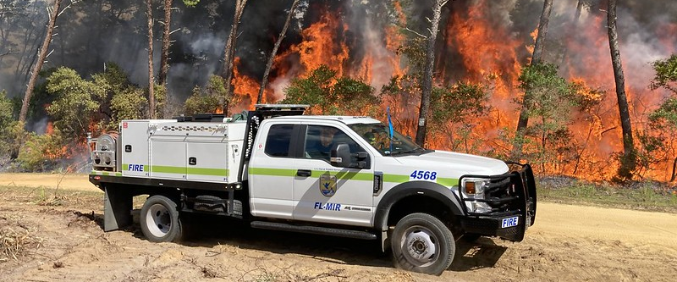
Type 7 Wildland Engine
Minimum requirements
Type 7 – GPM 10, 200 ft. hose, 2 personnel
Notes:
Major Fire in Florida | A brush truck from Merrit Island Nat… | Flickr

Slide 18
Engine Sources
Federal/Cooperators
Engines may be federal, state, and/or local government resources.
Contract/Virtual Incident Procurement (VIPR) Dispatch Priority Lists (DPLs)
Incident Only Agreements
Not available for reassignment

Slide 19
Engine Configuration
Without configuration
Single resource: Each engine is assigned an individual equipment request.
With configuration
Each engine is assigned an individual equipment request.
The roster is in Interagency Resource Ordering Capability (IROC).
Each engine crew member is assigned a request number, which is a sequential subset of an equipment number.

Slide 20
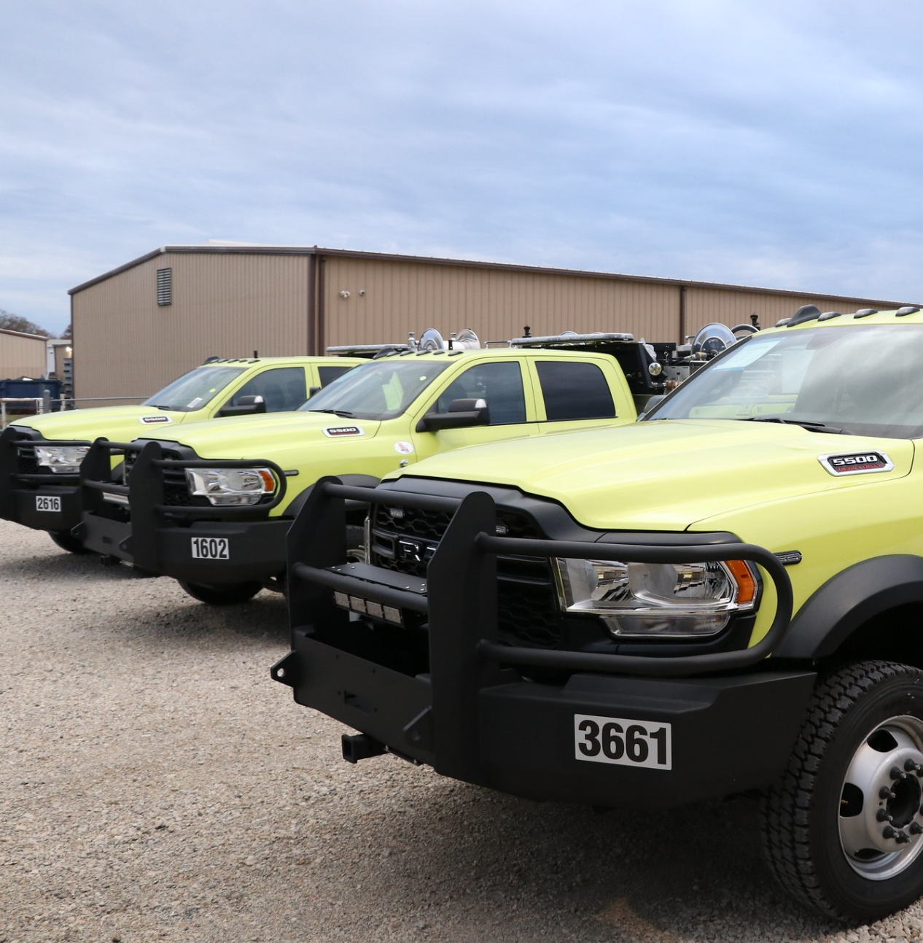
Strike Teams
Generally, not ordered nationally.
Consist of five or more like engines and a Strike Team Leader Engine (STEN).
Follow local procedures when ordering.
Notes:
BLM Equipment Inspections | The Bureau of Land Management se… | Flickr

Slide 21
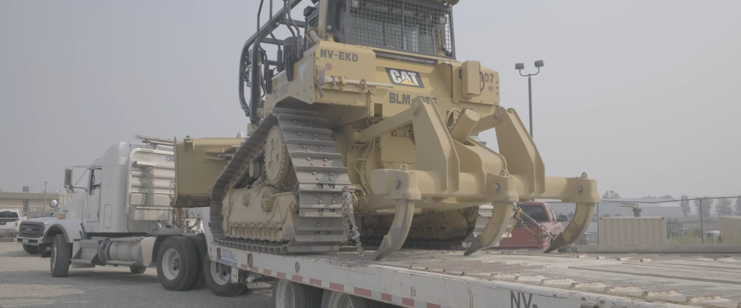
Rolling Stock (1 of 2)
Equipment with wheels or tracks
Tractor with lowboy and dozer
Notes:
dozer_Elko_081721 | Dozer, 08/17/2021, Elko, Nevada, Marc Sa… | National Interagency Fire Center | Flickr

Slide 22
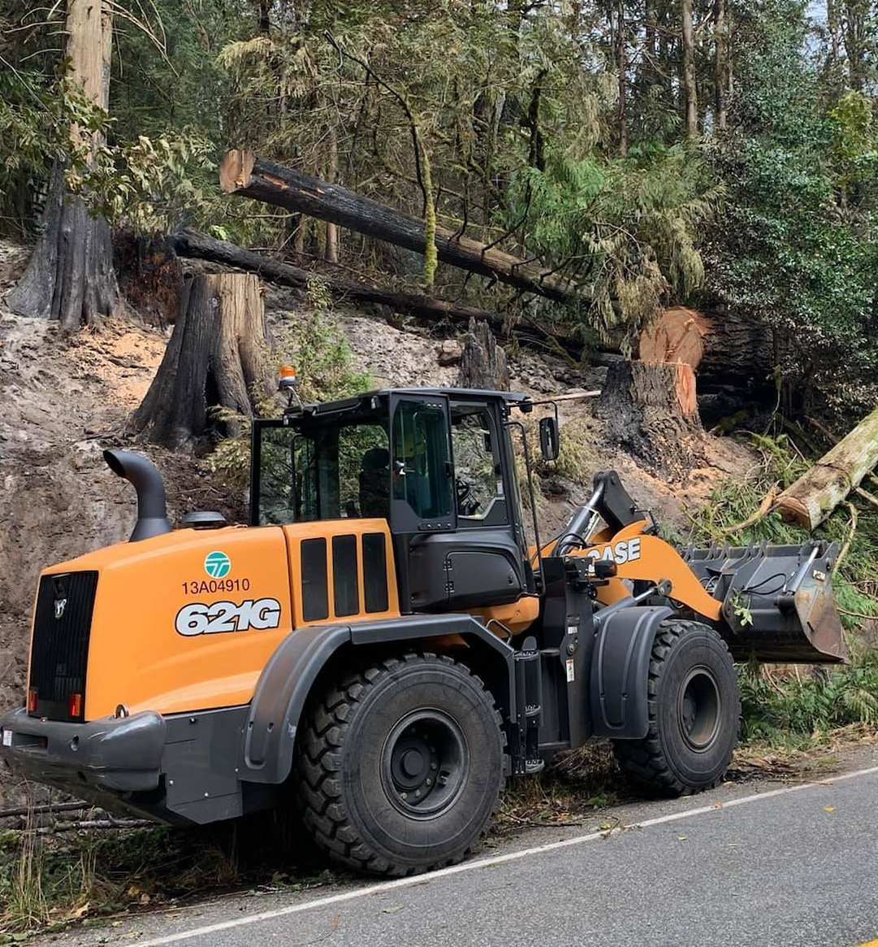
Rolling Stock (2 of 2)
Water tender
Tractor/plow
Notes:
Heavy Equipment Road Clearance, Bolt Creek Fire, Washingto… | Flickr

Slide 23
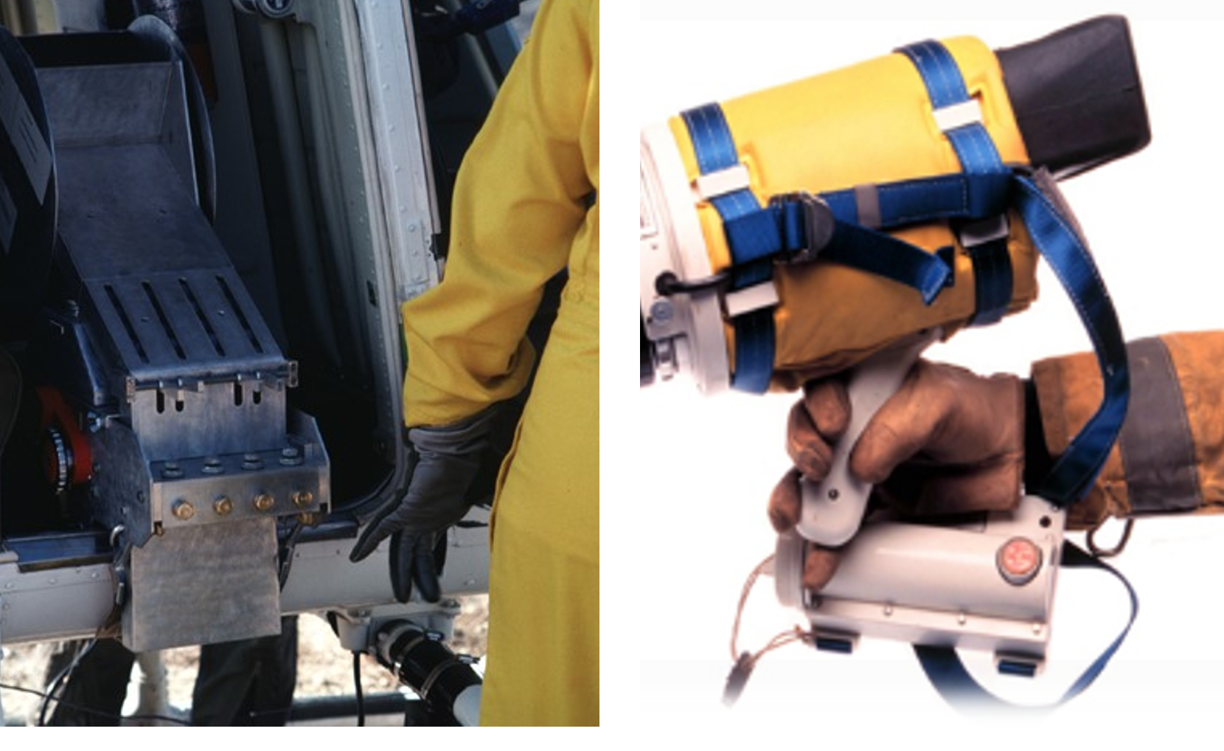
Specialized Equipment
Palm IR
Helitorch
Aerial ignition
Terra Torch

Slide 24
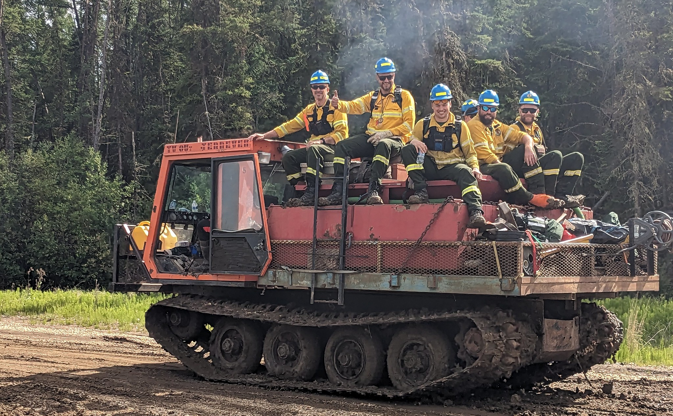
Additional Equipment
Notes:
Kimiwon Fire in Canada 2 | 2023 BLM Fire Employee Photo Cont… | Flickr

Slide 25
Acquisition Sources
Federal
Cooperators
VIPR DPLs
Service and Supply Plan
Admin unit/local agency
Contracts
Contracting or Buying Team (BUYT) can assist
Inspection and inventory
National Guard (area, state specific)

Slide 26
Driving Duty Limitations
Federal Motor Carriers Safety Regulations: Commercial Driver’s License (CDL)
10 hours driving time in a 15-hour duty day
8 hours off between shifts
References:
NWCG Standards for Interagency Incident Business Management, PMS 902, Chapter 10
National Interagency Standards for Resource Mobilization, Objectives, Policy, and Scope of Operation

Slide 27
Equipment Operators
Might be ordered at the same time
May come with specialized equipment (no separate O number)
May be on a support order with an O number (work with the Overhead function)

Slide 28
Summary
Equipment resources include national mobile caterers/mobile shower facilities, engines, rolling stock, and specialized equipment.
Be sure to complete required forms in order to mobilize national equipment resources.
Engines can be sourced via agency/cooperators, contract/VIPR DPLs, and Incident Only Agreements.
Follow local procedures when ordering strike teams.
Equipment acquisition sources include agency, cooperators, Service and Supply Plan, and the National Guard.
Follow driving duty limitations guidance.
Equipment operators might be ordered at the same time, may come with specialized equipment (no separate O number), or may be on a support order with an O number.

